Slide 1
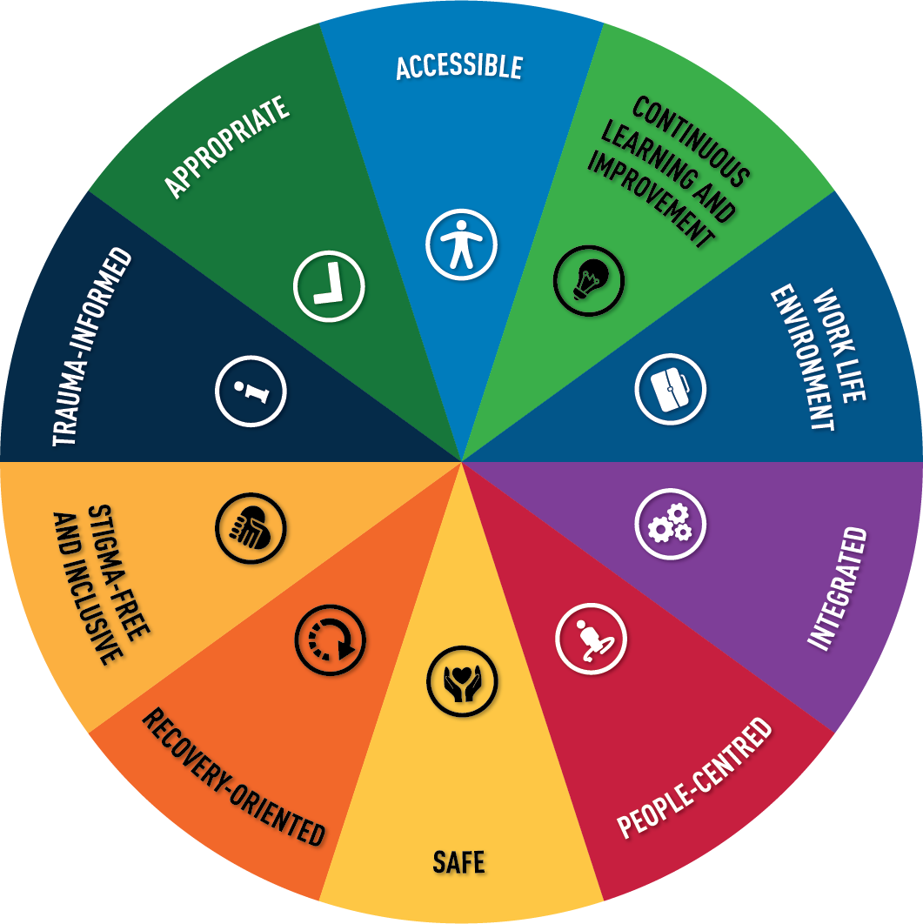

Better for all
Adopting the Quality Mental
Health Care Framework

Slide 2
A real and pressing need

Slide 3
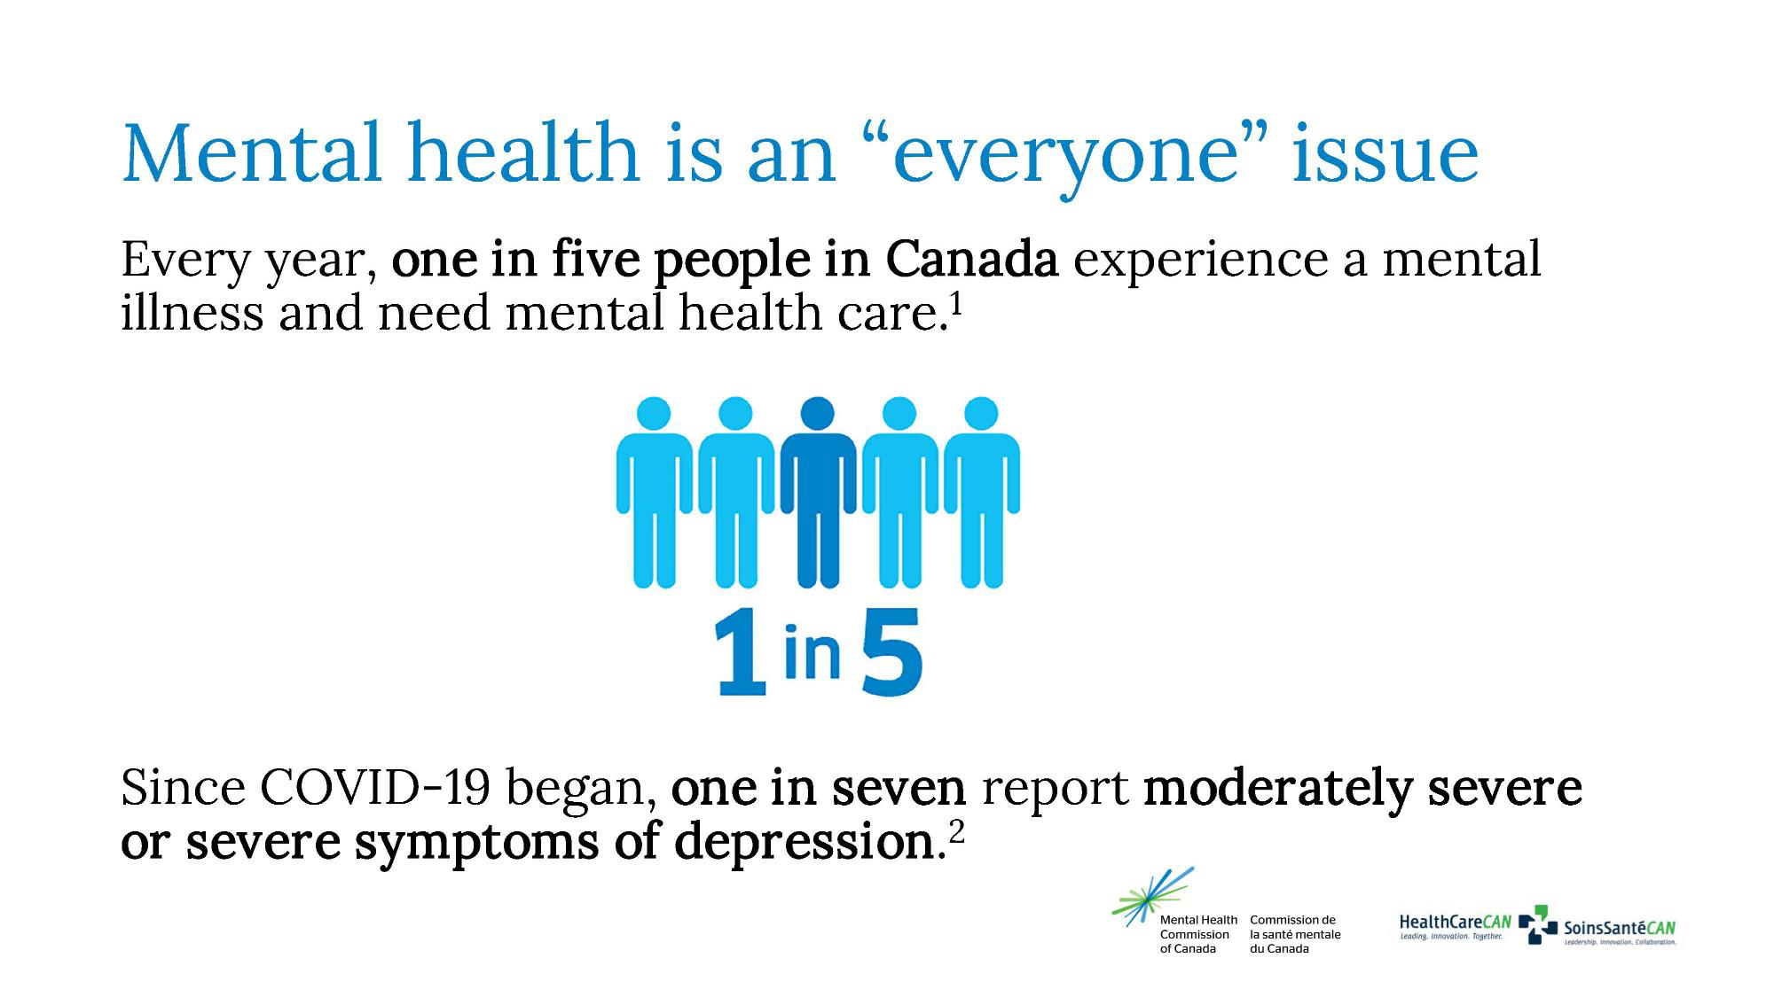
Notes:
Every year, around 20 percent of Canada’s population experiences a mental illness that requires access to mental health services.^{i}
COVID-19 has intensified the pressures on many people in Canada. Before the pandemic, about two percent reported moderately severe or severe symptoms of depression. Today, that number has skyrocketed to 14 percent, or one in seven people.^{ii}
^{i}Mental Health Commission of Canada. Making the case for investing in mental health in Canada. Published 2013. Accessed January 31, 2022.
Available at: https://www. mentalhealthcommission.ca/sites/default/files/2016-06/Investing_in_Mental_Health_FINAL_Version_ENG.pdf
^{ii}COVID-19 impacts on the mental health and substance use (MHSUH) workforce in Canada, CHWN: https://www.hhr-rhs.ca/images/MHSU_Infographic-FINAL_v2.pdf

Slide 4
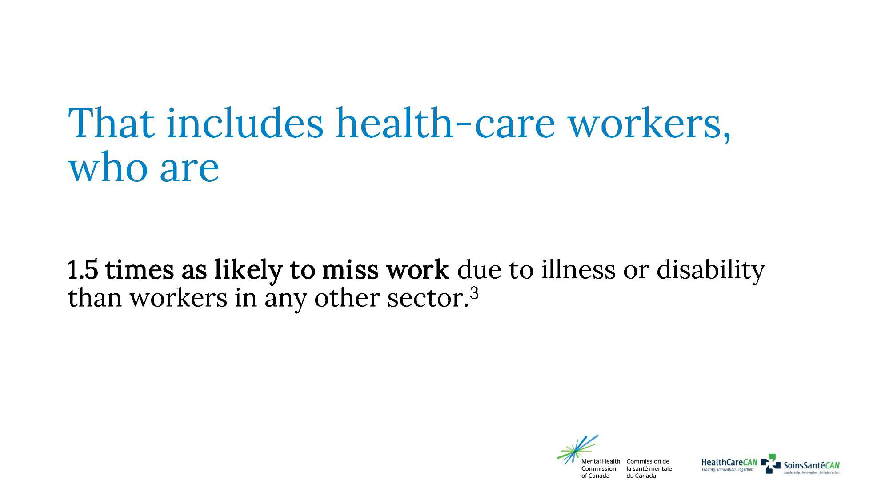
Notes:
Not only do more people need care today; their needs are also becoming more complex. Those changes are happening at a time when 43 percent of mental health and substance use health-care providers say they have less capacity to deliver services than they did pre-pandemic^{iii}. And even before COVID-19, health-care workers were suffering from stress, depression, anxiety, burnout and risk of suicide. They were already one-and-a-half times as likely to need time off due to illness or disability than workers in any other sector.^{iv}
^{iii.} Canadian Health Workforce Network, & Mental Health Commission of Canada. (2021).
^{iv.} Casselman, N. (2013, June 18). Wellness metrics in action.

Slide 5
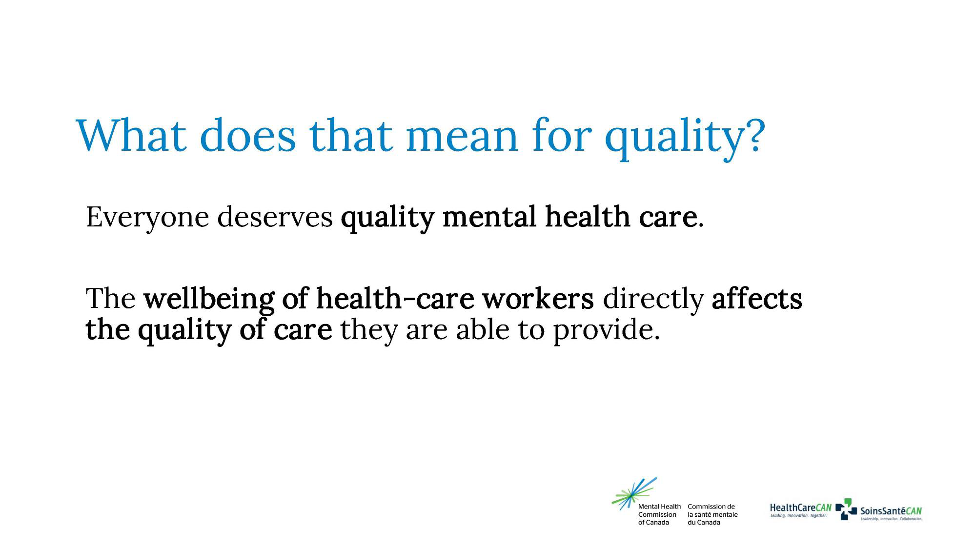
Notes:
Anyone with a need should have access to quality mental health care no matter where they live or what circumstances they are in.
The well-being and mental health of health-care workers can make a tremendous difference in the quality of care they (and their organizations) can provide. Other disparities can arise from the fact that mental health care is delivered in many different settings by many different types of professionals using a wide range of treatment modalities.
Access, availability, and quality are not consistent from jurisdiction to jurisdiction. And rural areas are particularly underserved.
So how can we improve mental health inside health care organizations — and improve the quality of care that is delivered to people in Canada?
That was the question the Quality Mental Health Care Network posed…

Slide 6
About the Quality Mental Health Care Framework

Slide 7
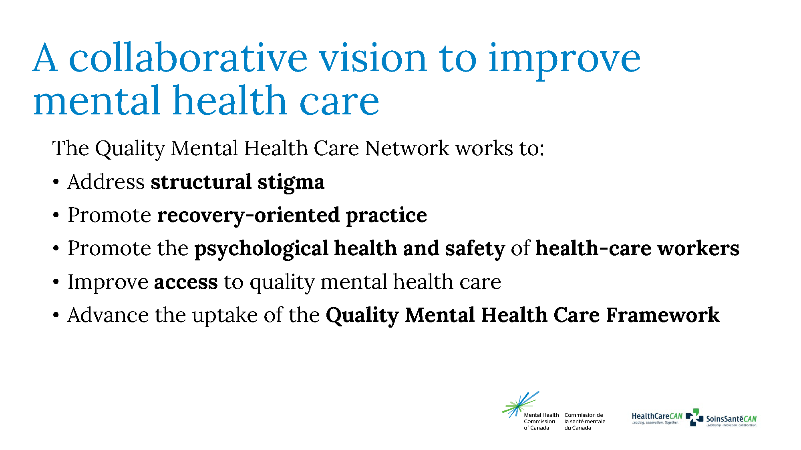
Notes:
The roots of the Quality Mental Health Care Network go back to the By Health, For Health Collaborative co-led by HealthCareCAN and the Mental Health Commission of Canada (MHCC).
The key goal of the Collaborative, which included representatives from more than 20 health-care organizations, was to have health-care workplaces become leaders and role models in providing psychologically healthy and safe environments for all people in Canada. It was a driving force behind the growing focus on this workplace mental health and it was also a champion for the implementation of the National Standard of Canada for Psychological Health and Safety in the Workplace.
Building on the success of the Collaborative, HealthCareCAN and the MHCC now co-lead the Quality Mental Health Care Network, which unites health-sectors leaders across the country to remove access barriers to high-quality mental health-care services. The Network’s efforts address structural stigma, promote recovery-oriented practice and improve access to quality mental health care.
One of its key initiatives is developing the Quality Mental Health Care Framework to define quality mental health care and identify the essential dimensions that enable its provision.

Slide 8
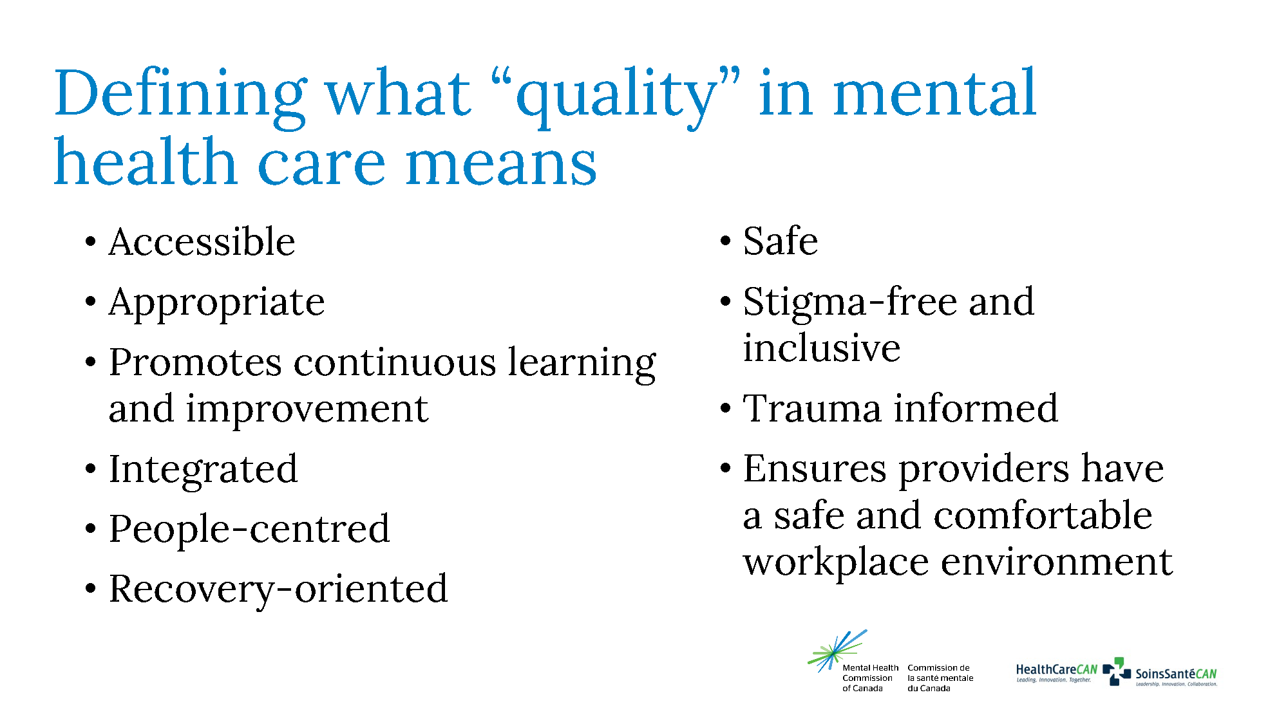
Notes:
Before a framework could be developed, the Network needed a definition of ”quality mental health care” that it would support.
Arriving at a workable definition was challenging because both “quality” and “mental health” mean so many things to different people.
In consultation with health professionals and people with lived and living experience (including both patients and caregivers), it arrived at the following definition:
Quality mental health care is accessible, appropriate, promotes continuous learning and improvement, is integrated, people-centred, recovery-oriented, safe, stigma-free and inclusive, trauma-informed, and ensures providers have a safe and comfortable workplace environment.
This definition forms the basis for the Quality Mental Health Care Framework.

Slide 9
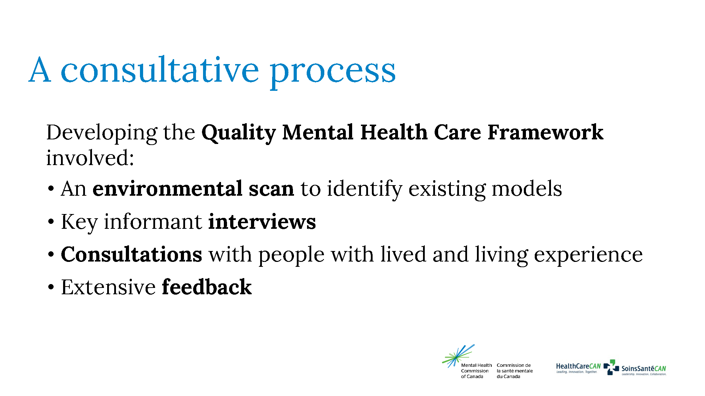
Notes:
Developing the Framework is one of the Network’s major initiatives.
It started with an environmental scan to look at existing provincial, territorial, national and international health-care frameworks. This resulted in identifying 14 frameworks for closer review and analysis.
Next was a series of interviews with 20 key informants, including health professionals from across Canada with experience in mental health care. They were asked four primary questions:
What existing quality care frameworks would be helpful in developing a framework for quality mental health care?
What quality dimensions common to these frameworks would apply to mental health care?
What aspects unique to mental health care should be incorporated into a framework for quality mental health care?
What words and/or concepts come to mind when you think of quality mental health care?
An analysis of the responses led to adding seven more frameworks to the reference collection and developing an initial draft of the Framework.
The next step involved three focus groups with people who have lived and living experience. After sharing the draft Framework with these groups, each was asked three primary questions:
What words and/or concepts come to mind when you think of quality mental health care?
What aspects unique to mental health care should be incorporated into a framework for quality mental health care?
What gaps, if any, need to be addressed in the framework? Are there dimensions in the framework that should be reworked or eliminated?
Based on the recommendations of the focus groups, the Network revised and developed the final Quality Mental Health Care Framework.

Slide 10
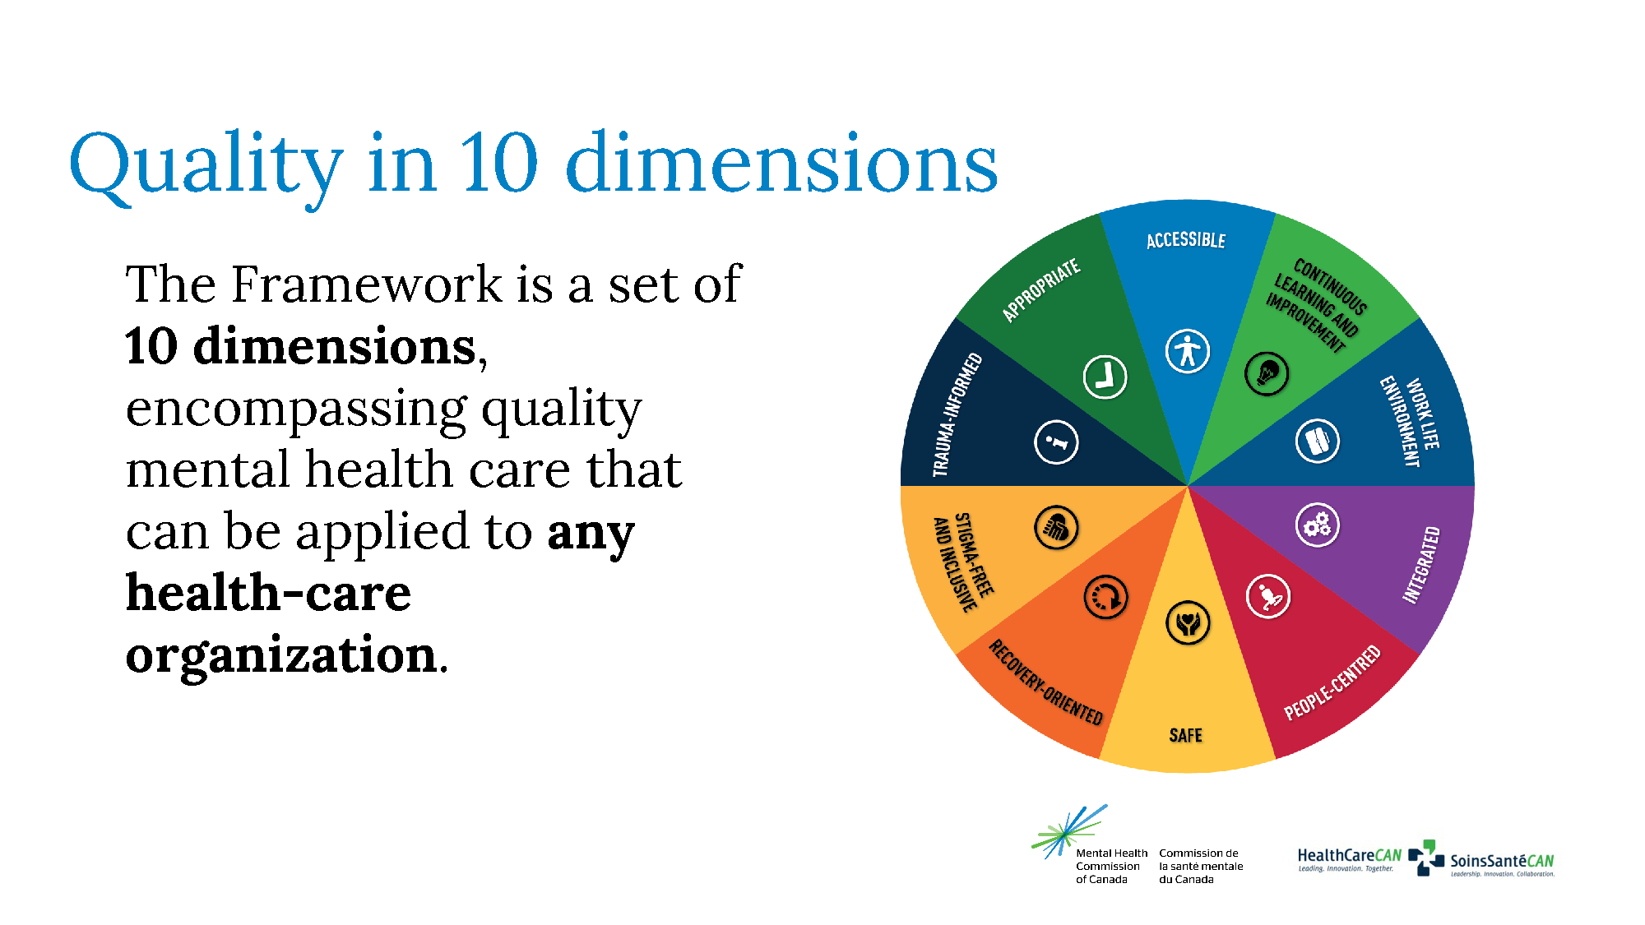
Notes:
The Quality Mental Health Care Framework is a set of 10 dimensions encompassing quality mental health care that can be applied to any health care organization. It seeks to ensure that the care being provided meets the needs of recipients while supporting a healthy work-life environment for providers.
In building on the definition of “quality mental health care”, it offers a framework health-care organizations can use to assess the care they’re providing.
Developed in consultation with health-care providers and people with lived and living experience, it also seeks to ensure that anyone accessing mental health services receives a high standard of care that supports progress toward their recovery goals.

Slide 11
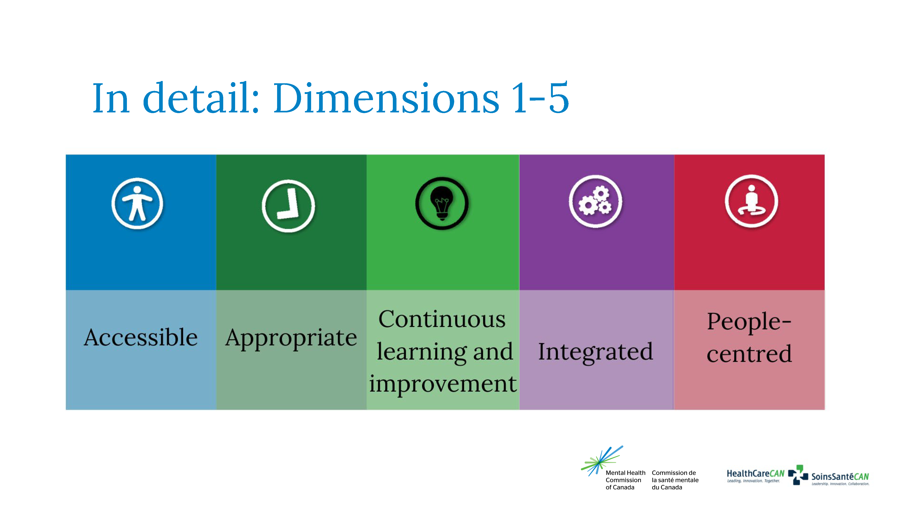
Notes:
The first dimension of quality mental health care is accessibility. All clients should have timely and equitable access to care across the continuum. Care is most effective when it promotes prevention and early intervention and supports community-based interventions.
Example: E-mental health services can help clients access care even if they’re not located near a provider’s office or clinic.
Second is appropriateness. All care should be evidence informed and be provided by culturally competent staff.
Example: Canada’s population is extremely diverse, and services that are appropriate for one group may not be culturally appropriate for another. With cultural competency and tailored services, all clients can receive care that meets their needs.
Next is continuous learning and improvement. When organizations and colleagues share knowledge and encourage and support innovative care, they build their capacity to enhance quality care.
Example: Evidence is always evolving as scientific knowledge advances. Continuous learning programs such as HealthCareCAN’s CHA Learning platform can help ensure that service providers are always working with the latest evidence.
The fourth dimension is integration. Care should be uninterrupted across the continuum, and transitions into community settings should be smooth. Ideally, a client’s family or other support system will be involved with all aspects of care. Where possible, mental health care services can be integrated with services that address social determinants of health.
Example: Clients who have been involved with the criminal justice system often continue to face additional barriers to health and recovery, such as difficulty accessing housing and employment. Integrated services work to address all related social determinants of health.
Next is being people-centred. High-quality care is focused on and organized around the health needs and expectations of the people and communities receiving services – not on disease.
Example: People with mental illness are more than their illness. Their care needs account for their needs as a person, rather than focusing exclusively on clinical symptoms and diagnoses.

Slide 12
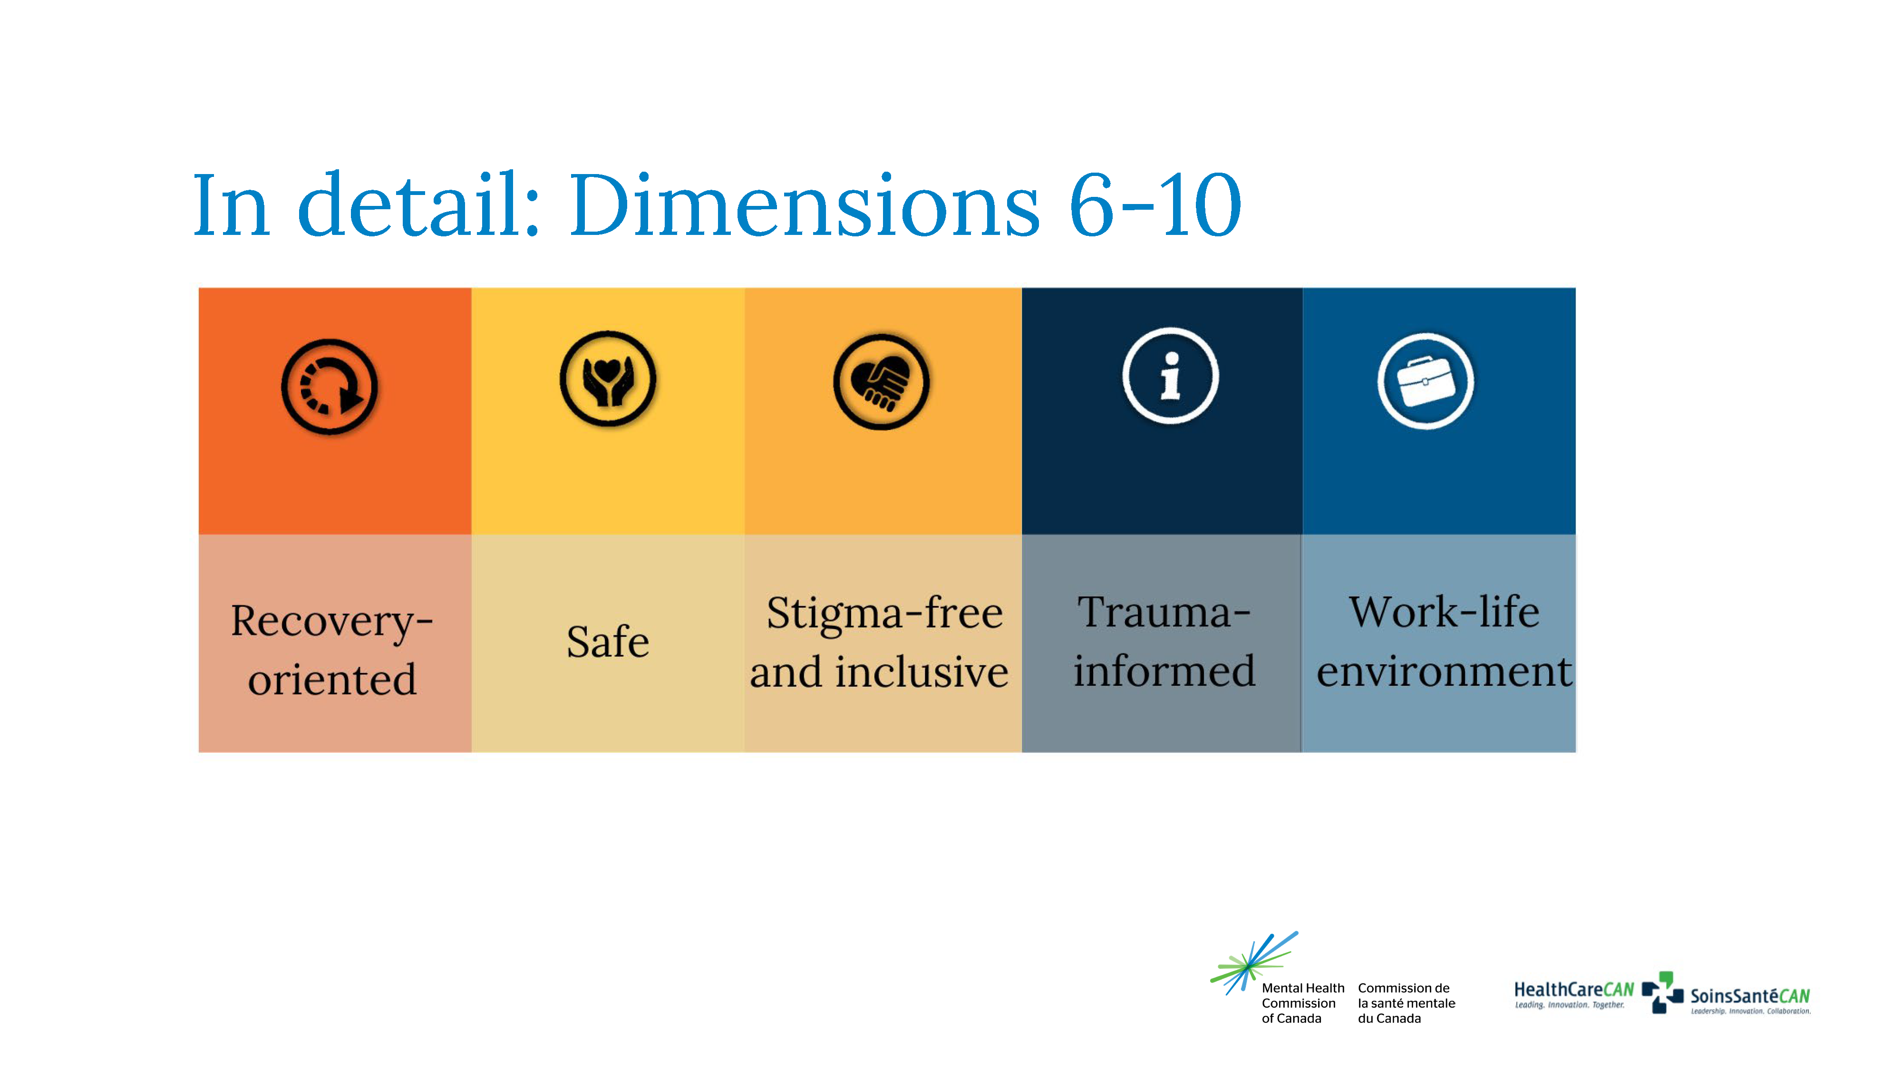
Notes:
The sixth dimension calls for quality mental health care to be recovery oriented. High-quality care supports people in living satisfying, hopeful, and meaningful lives, regardless of any ongoing limitations related to mental health problems or illnesses.
Example: Instead of imposing treatment plans on clients, in recovery-oriented practice service providers and clients work together to create plans based on service users’ own goals.
The seventh dimension is safe. Keep clients and providers safe from preventable harm. Care should be culturally safe across the continuum for all individuals and communities.
Example: When mental illness intersects with other human characteristics that are subject to marginalization, the effects of both can multiply. Delivering care through anti-racism, anti-oppression frameworks can help ensure the safety of all clients.
Next is stigma-free and inclusive. High-quality care addresses multiple layers of stigma (individual, interpersonal, intersectoral and structural) and prevents stigmatizing practices in mental health care. In a stigma-free environment, health-care providers can be comfortable coming forward at work with their own mental health problems and illnesses. Organizations and providers need to support those who have experienced stigma and discrimination and help all individuals feel respected and valued.
Example: When clients are dismissed or treated poorly due to mental illness, they are less likely to seek or receive the care they need. Taking action to address all forms of stigma is one of the most important ways to improve care.
The ninth dimension is trauma-informed. All care should be provided while recognizing and understanding the impacts of trauma and violence on individuals receiving mental health care services.
Example: Mental illness is often accompanied by a history of trauma, so organizations must protect clients from re-traumatization by ensuring that all care is delivered using a trauma-informed lens.
The final dimension of quality mental health care is the work-life environment. A healthy workplace environment supports provider wellness and promotes psychological safety.
Example: Adopting the National Standard of Canada for Psychological Health and Safety in the Workplace is an effective way to promote a work environment that keeps staff healthy.

Slide 13
Reaping the benefits

Slide 14
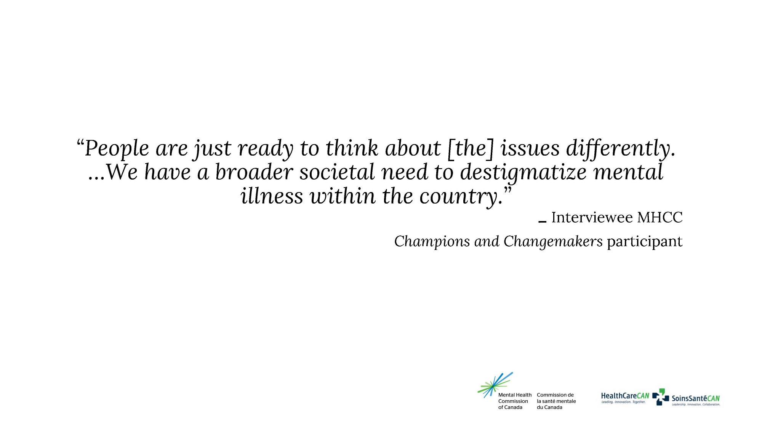

Slide 15
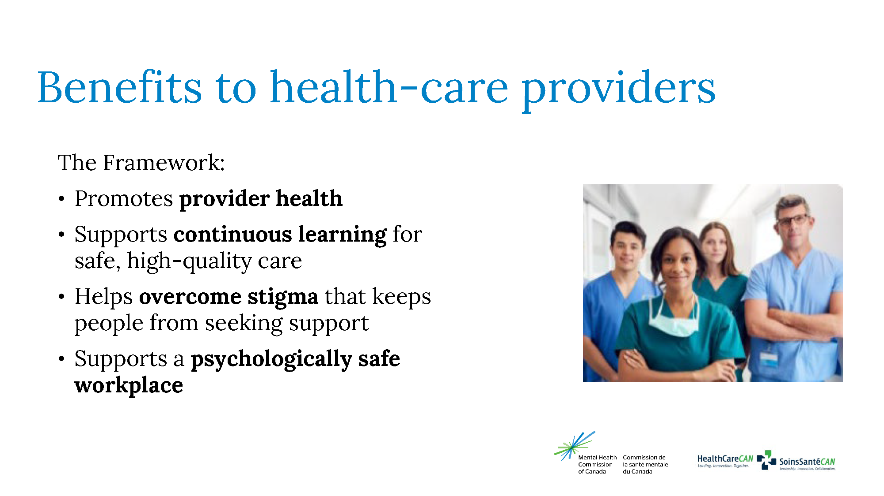
Notes:
It’s important to recognize that health-care workers are people first, which means that it’s critical to protect their health — and their mental health. Besides being the right thing to do, keeping health-care workers healthy is critical to the quality of care they provide. When providers get burned out, stressed or sick, they’re less able to deliver the care people need. That’s why the Framework includes dimensions that are specifically intended to protect and promote the health and wellbeing of health-care workers.
It recognizes the need for a healthy work-life environment to keep them safe and healthy, and highlights provider and patient safety as one of its dimensions. The continuous learning dimension also supports providers by ensuring that their knowledge and skill sets evolve with the evidence so they can deliver the best, safest care.

Slide 16

In their own words
Notes:
Video Access denied: How mental health/substance use-related structural stigma impacts health-care access
https://mentalhealthcommission.ca/resource/access-denied-how-mental-health-substance-use-related-structural-stigma-impacts-health-care-access/

Slide 17
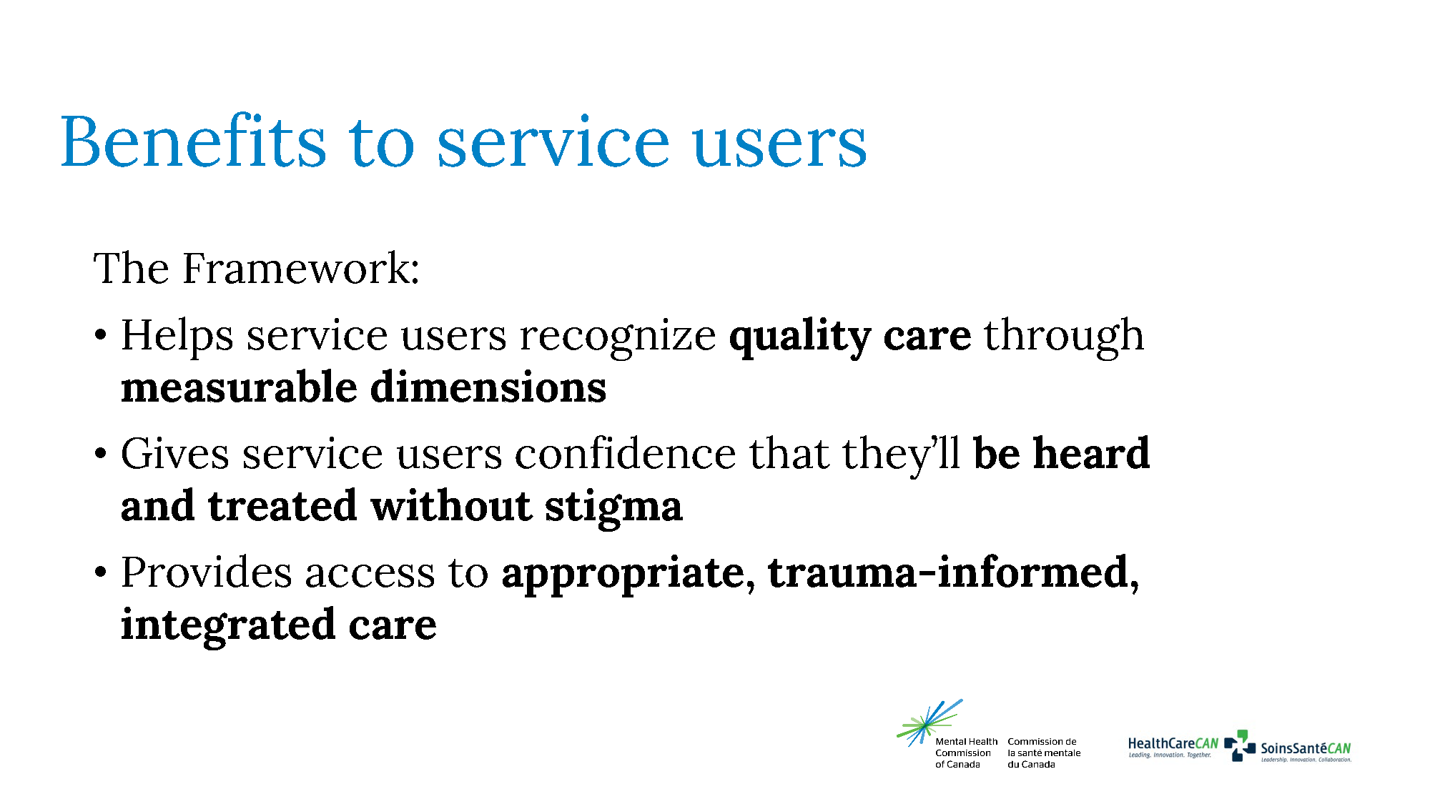
Notes:
The experience of receiving health care can be overwhelming, and service users aren’t necessarily experts on what quality care looks like. This is especially true for mental health care, where stigma can lead to negative, harmful experiences that make people hesitant to seek the treatment they need.
The Framework provides clear, measurable dimensions that give service users the confidence to identify quality care and advocate for it when certain areas fall short. By adopting the Framework and declaring their commitment to providing services that meet all 10 dimensions, health care organizations can send a clear message to people who are seeking services.
This helps ensure better quality care that is trauma-informed and free of stigma, so service users receive what they need to prioritize their recovery.

Slide 18

In their own words
Notes:
Videos:
Rainbow Youth Health: https://www.youtube.com/playlist?list=PL2NuAPXp8ohZ5nHS7069VoBDRLrGnhePJ
Emerging Adults Seek Change in Mental Health Services: https://www.youtube.com/playlist?list=PL2NuAPXp8ohbUt1WW0ga4afMYMmRSr7WZ
NOTE FOR PRESENTER: This emerging adults series includes multiple stories. Feel free to select one that best suits your audience.

Slide 19

Notes:
Not only do more people need care today; their needs are also becoming more complex. Those changes are happening at a time when 43 percent of mental health and substance use health-care providers say they have less capacity to deliver services than they did pre-pandemic^{iii}. And even before COVID-19, health-care workers were suffering from stress, depression, anxiety, burnout and risk of suicide. They were already one-and-a-half times as likely to need time off due to illness or disability than workers in any other sector.^{iv}
^{iii.} Canadian Health Workforce Network, & Mental Health Commission of Canada. (2021).
^{iv.} Casselman, N. (2013, June 18). Wellness metrics in action.

Slide 20
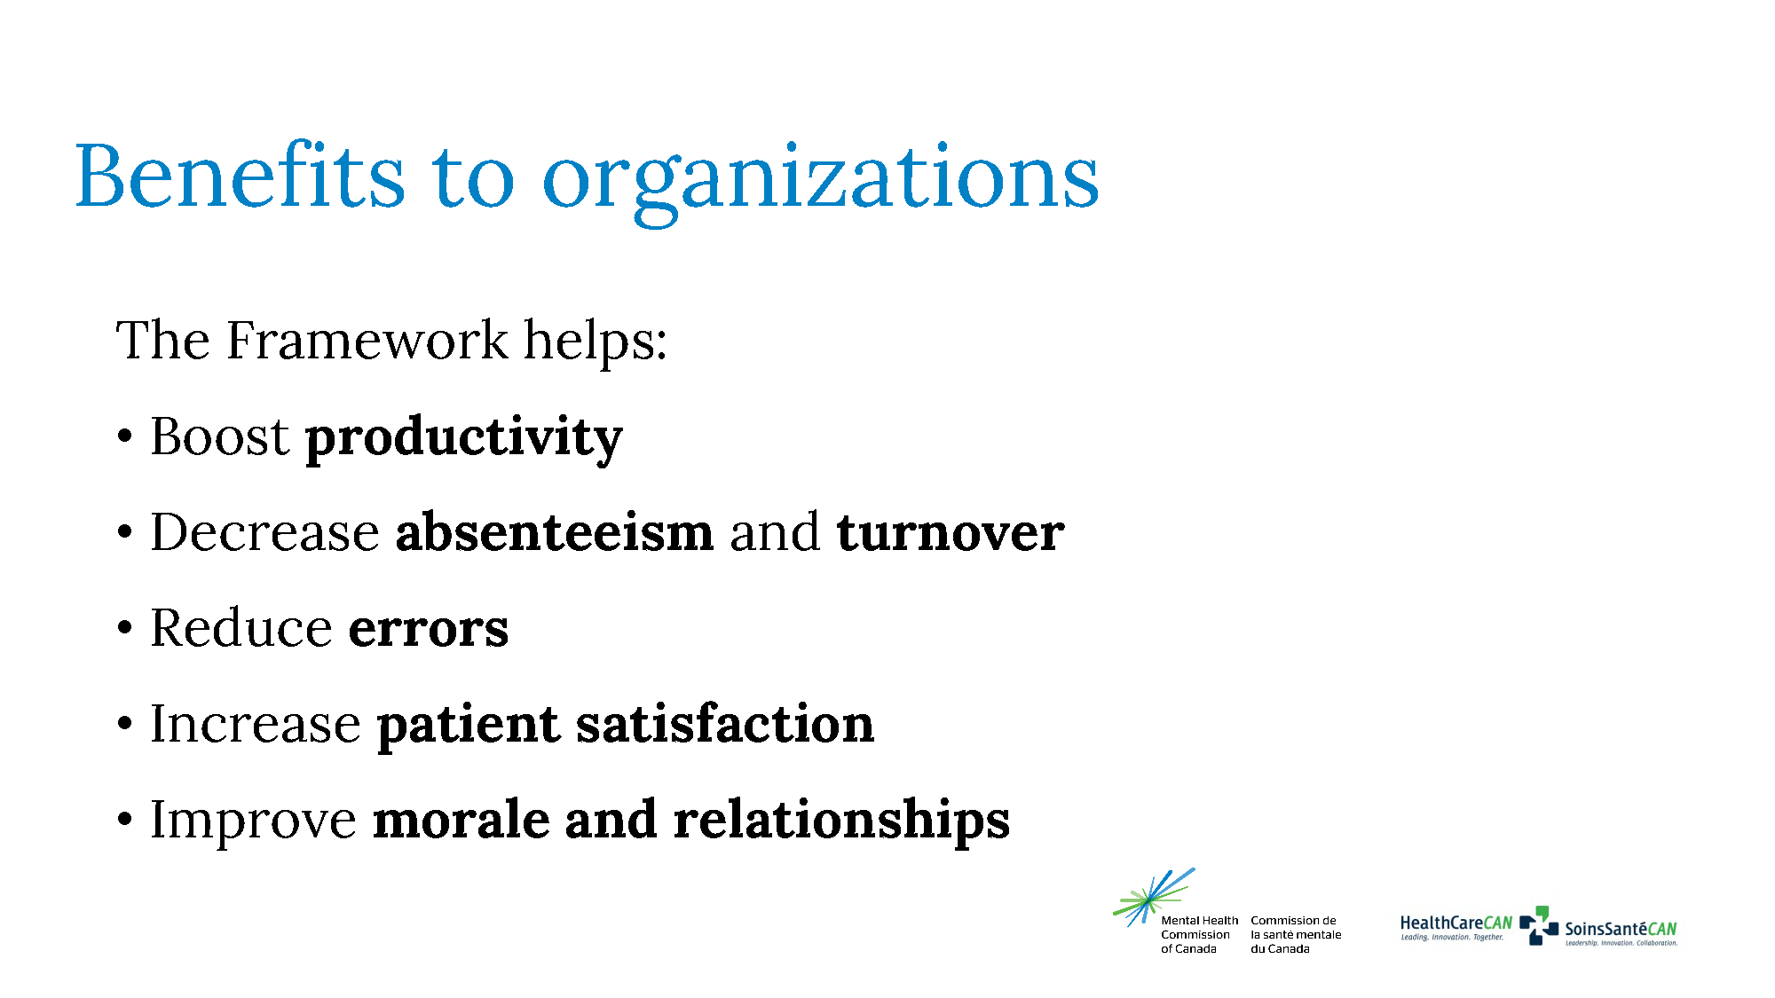
Notes:
By supporting the mental health of both service users and staff, the Quality Mental Health Care Framework provides a range of organizational benefits:
It can make staff more productive, which helps lower operational costs.
It decreases absenteeism and turnover and can help with recruitment and supporting staff when they return to work from leave.
It reduces the likelihood of errors, such as patients not receiving Accessible, Integrated, Trauma-Informed, etc. care as per the definitions provided for these dimensions.
It increases client satisfaction and enhances the reputation of the organization.
It improves overall morale and the relationships among staff and between staff and service users.

Slide 21
Resources to get you started

Slide 22
Resources:
These background, information, and guidance resources will help bring the Framework’s 10 dimensions into health-care organizations
The Quality Mental Health Care Network
^{Mental and physical health}
Towards better mental and physical health: Preventing and managing concurrent mental and physical conditions
^{E-Mental Health}
^{E-Mental Health}
Notes:
These resources can help bring the dimensions of quality mental health care into an organization. They provide background, information, and guidance.
The Quality Mental Health Care Network: https://mentalhealthcommission.ca/quality-mental-health-care-network/
Towards better mental and physical health: Preventing and managing concurrent mental and physical conditions
https://mentalhealthcommission.ca/resource/preventing-and-managing-concurrent-mental-and-physical-conditions/
E-Mental health: https://mentalhealthcommission.ca/what-we-do/e-mental-health/

Slide 23
Resources (cont’d):
Access
Expanding access to counselling, psychotherapy, and psychological services
Access to quality mental health care
Specific populations
Children and youth
Older adults
Caregiving
Mental health and the justice system
Creating safer spaces for 2SLGBTQ+ emerging adults in health care
Recovery and inclusiveness
Diversity
Recovery
Notes:
Expanding access to counselling, psychotherapy, and psychological services: https://mentalhealthcommission.ca/expanding-access-to-counselling-psychotherapy-and-psychological-services/
Access to quality mental health care: https://mentalhealthcommission.ca/what-we-do/access/
Children and youth: https://mentalhealthcommission.ca/what-we-do/children-and-youth/
Older adults: https://mentalhealthcommission.ca/what-we-do/older-adults/
Caregiving: https://mentalhealthcommission.ca/what-we-do/caregiving/
Mental health and the justice system: https://mentalhealthcommission.ca/what-we-do/mental-health-and-the-justice-system/
Creating safer spaces for 2SLGBTQ+ emerging adults in health care: https://mentalhealthcommission.ca/resource/mhcc-w2a-rainbow-youth-health-forum-report/
Diversity: https://mentalhealthcommission.ca/what-we-do/diversity/
Recovery: https://mentalhealthcommission.ca/recovery/

Slide 24
Resources (cont’d):
Stigma
Structural stigma
Understanding stigma (Centre for Addiction and Mental Health [CAMH])
Workforce
Aspiring workforce
The Working Mind Healthcare
Advancing psychological health and safety within healthcare settings
HealthCareCAN’s Professional Development Division, CHA Learning (HealthCareCAN)
Notes:
Structural stigma: https://mentalhealthcommission.ca/structural-stigma/
Understanding stigma (Centre for Addiction and Mental Health [CAMH]): https://www.camh.ca/en/education/continuing-education-programs-and-courses/continuing-education-directory/understanding-stigma
Aspiring workforce: https://mentalhealthcommission.ca/aspiring-workforce/
The Working Mind Healthcare: https://theworkingmind.ca/working-mind-healthcare
Advancing psychological health and safety within healthcare settings: https://mentalhealthcommission.ca/what-we-do/workplace/workplace-healthcare/
HealthCareCAN's Professional Development Division, CHA Learning (HealthCareCAN): https://www.chalearning.ca/

Slide 25
Resources (cont’d):
Videos
Access Denied: How Mental Health – and/or Substance Use-Related Structural Stigma Impacts Health-Care Access
“Less Than”: How Mental Health- and/or Substance Use-Rated Structural Stigma Impacts Quality of Care
A Way Forward: How We Can Dismantle Mental Health/and/or Substance Use-Related Structural Stigma
Advancing Psychological Health and Safety in Health-Care Settings
Advancing Psychological Health and Safety for Health-Care Workers
Creating Safer, More Inclusive Spaces for 2SLGBTQ+ Emerging Adults in Health-Care Settings
Food for Thought: A Youth Perspective on Recovery-Oriented Practice
Promoting and Strengthening Post-Secondary Student Mental Health
Emerging Adults Seek Change in Mental Health Services
Notes:
Access Denied: How Mental Health- and/or Substance Use-Related Structural Stigma Impacts Health-Care Access
https://mentalhealthcommission.ca/resource/access-denied-how-mental-health-substance-use-related-structural-stigma-impacts-health-care-access/
“Less Than”: How Mental Health- and/or Substance Use-Related Structural Stigma Impacts Quality of Care
https://mentalhealthcommission.ca/resource/less-than-how-mental-health-and-or-substance-use-related-structural-stigma-impacts-quality-of-care/
A Way Forward: How We Can Dismantle Mental Health/ and/or Substance Use-Related Structural Stigma
https://mentalhealthcommission.ca/resource/a-way-forward-how-we-can-dismantle-mental-health-and-or-substance-use-related-structural-stigma/
Advancing Psychological Health and Safety in Health-Care Settings
https://mentalhealthcommission.ca/resource/join-the-movement-advancing-psychological-health-and-safety-in-healthcare-settings/
Advancing Psychological Health and Safety for Health-Care Workers
https://www.youtube.com/watch?v=Db6VZ5Fgy7w
Creating Safer, More Inclusive Spaces for 2SLGBTQ+ Emerging Adults in Health-Care Settings
https://www.youtube.com/playlist?list=PL2NuAPXp8ohZ5nHS7069VoBDRLrGnhePJ
Food For Thought: A Youth Perspective on Recovery-Oriented Practice
https://mentalhealthcommission.ca/resource/food-for-thought-a-youth-perspective-on-recovery-oriented-practice/
Promoting and Strengthening Post-Secondary Student Mental Health
https://mentalhealthcommission.ca/resource/promoting-and-strengthening-post-secondary-student-mental-health/
Emerging Adults Seek Change in Mental Health Services
https://www.youtube.com/playlist?list=PL2NuAPXp8ohbUt1WW0ga4afMYMmRSr7WZ

Slide 26
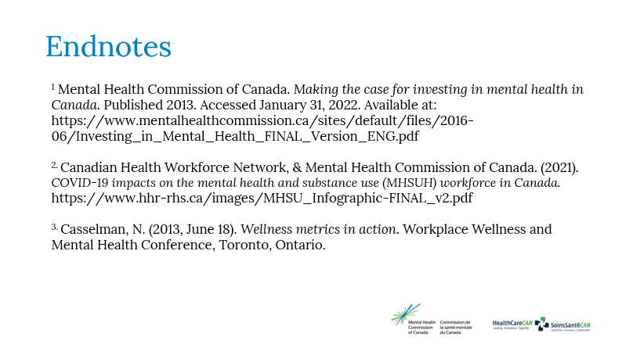

Slide 27

Questions?
For more information:

